Slide 1
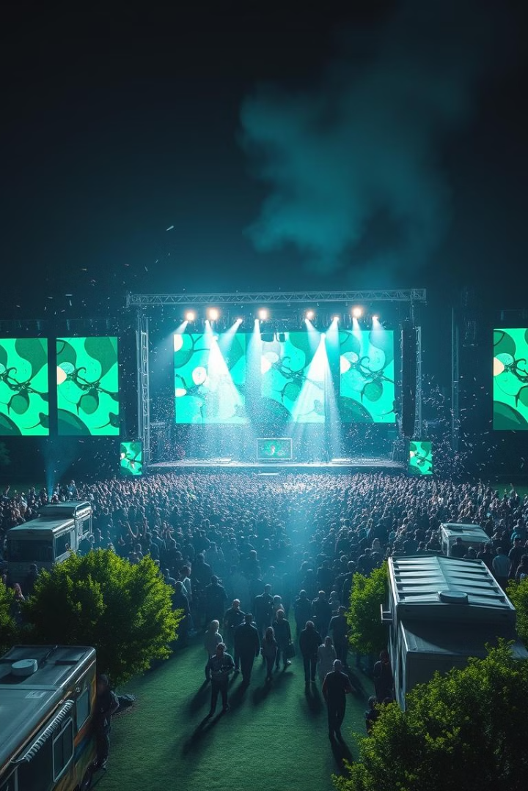
Finding Your Friends at Concerts: No Internet Needed!
Discover a peer-to-peer communication solution for locating friends at large events without internet. Overcome the challenges of overcrowded concerts with spotty connectivity. In a large scale events like concerts or festivals internet connectivity is often unreliable or completely unavailable. This makes it difficult for people to locate or reconnect with their friends in the crowd.

Slide 2
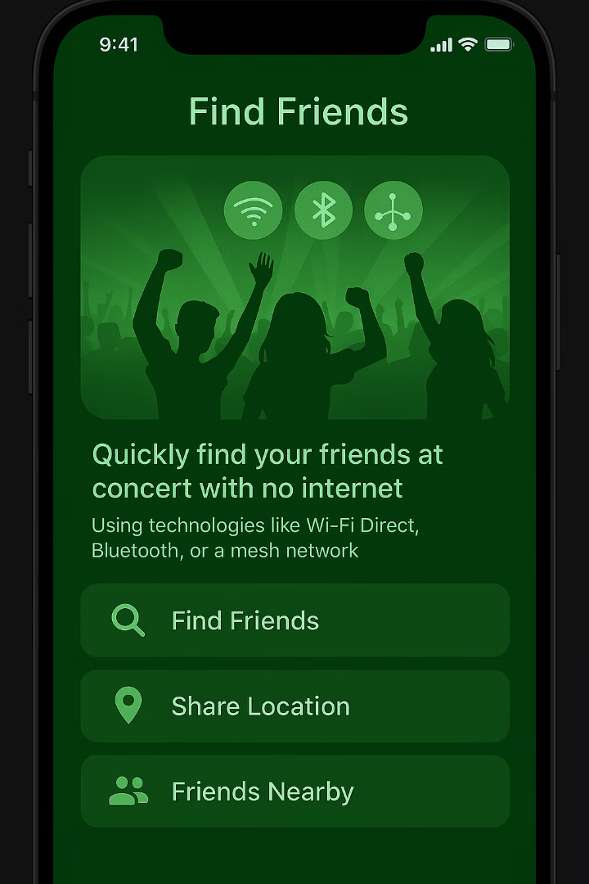
The Problem: Internet-Dependent Concerts
Network Congestion
Security Protocols
Unauthorized access is blocked, limiting connectivity options.
Overcrowding leads to network overload and unreliable connections.
Battery Drain
Constant network searching rapidly depletes device batteries.
Concertgoers spend an average of 15 minutes trying to find their friends. Current solutions are unreliable.

Slide 3
P2P Solution: Bluetooth
Bluetooth
Short-range, low power, ubiquitous technology.
Range: Up to 100 meters (Class 1).
Example: Bluetooth beacons for indoor navigation.
Bluetooth offer reliable peer-to-peer connections without relying on internet.

Slide 4
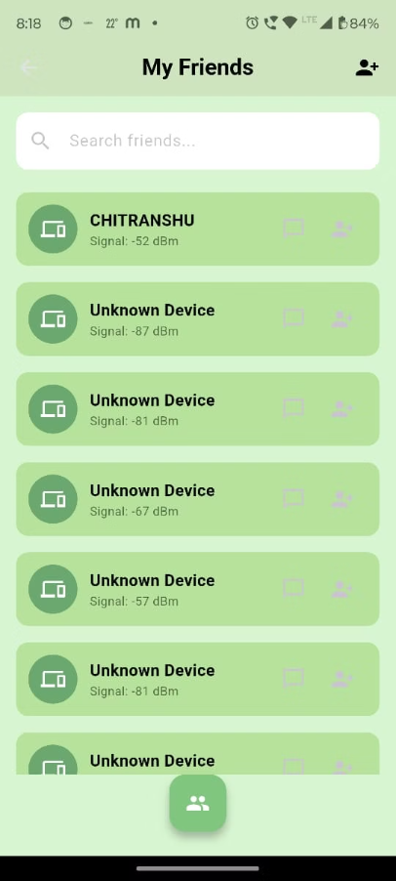
THE BLUETOOTH RANGE GAME :
Bluetooth range showing list of devices
The app when clicked on "Friends nearby" will switch on the bluetooth and shows the list of devices that comes within the range of the bluetooth network.

Slide 5

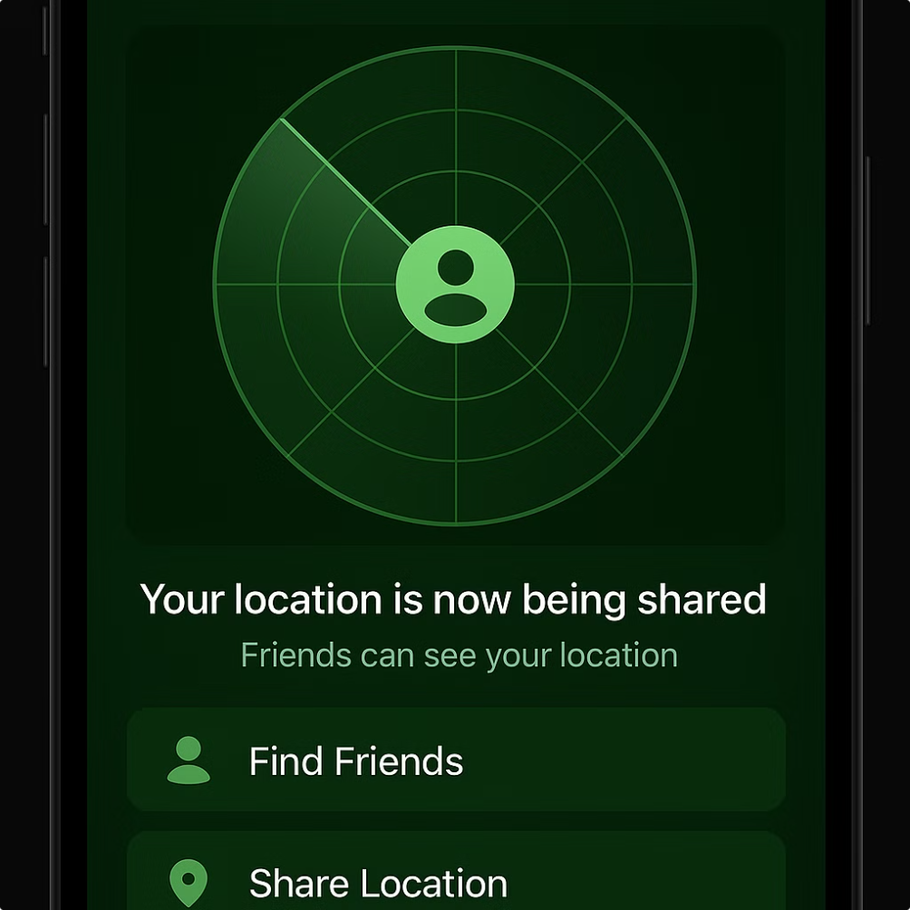
Alternative: Mesh Networking for Large Crowds
Direct Connection
Extended Range
Devices connect directly, creating a self-organizing network.
Multiple hops extend the network's reach and coverage.
Resilient
If one node fails, others maintain the connection for robust reliability.
Mesh networks, like goTenna devices used in disaster zones, ensure connectivity even when infrastructure is down.

Slide 6
Feasibility
Technical Feasibility
Economic Feasibility
Operational Feasibility
Mesh networking is achievable using:
No need for servers or cloud infrastructure( works offline).
Simple UX — add friends, find them, ping if needed
Bluetooth (BLE Mesh / Nearby Connections)
Build using open source tools and libraries.
Works without GPS or mobile data
Wi-Fi Direct for faster transfer
Easily testable in any closed environment (e.g. college campus)
Flutter + Native Plugins make integration possible
No internet= no charges
Designed for minimal user input (auto-detection)
Flutter ensures single codebase for android and ios, saving development cost.
Distance estimation via RSSI (signal strength) is proven and used in IoT
Future-proof with features like offline maps, AR, and alert systems
Works in real-time, even with limited battery usage (energy-efficient scanning)

Slide 7



How It Works: The P2P Concert App
Local P2P Connection
App creates a local peer-to-peer network through bluetooth.
Mesh network hops
At the needful time both the devices should have switched on blue
Offline Map(Lattitude and Longtitude navigation)
Location is displayed on an offline map for easy navigation.
The app uses BLE (Bluetooth Low Energy) for battery efficiency. Users can send pre-defined messages and set meeting points.

Slide 8
WORKING
STEP 1: The bluetooth is switched on both the devices and user id gets exchanged after successful connection.
STEP 2: At the time of need i.e concerts, rallies or crowded places when the bluetooth is switched on one device it searches for the user id of the required device.(already connected devices)
STEP 3: The uid gathered from one device via one app hops to another thereby repeating the process so that the source reaches the destination.( One device gathers the uid in a pattern towards destination with a maximum of 10 hops possible.)
STEP 4: The app shows the required distance one needs to cover to get closer to the destination through the lattitude and longtitude provided by using app and enjoy the concert!

Slide 9
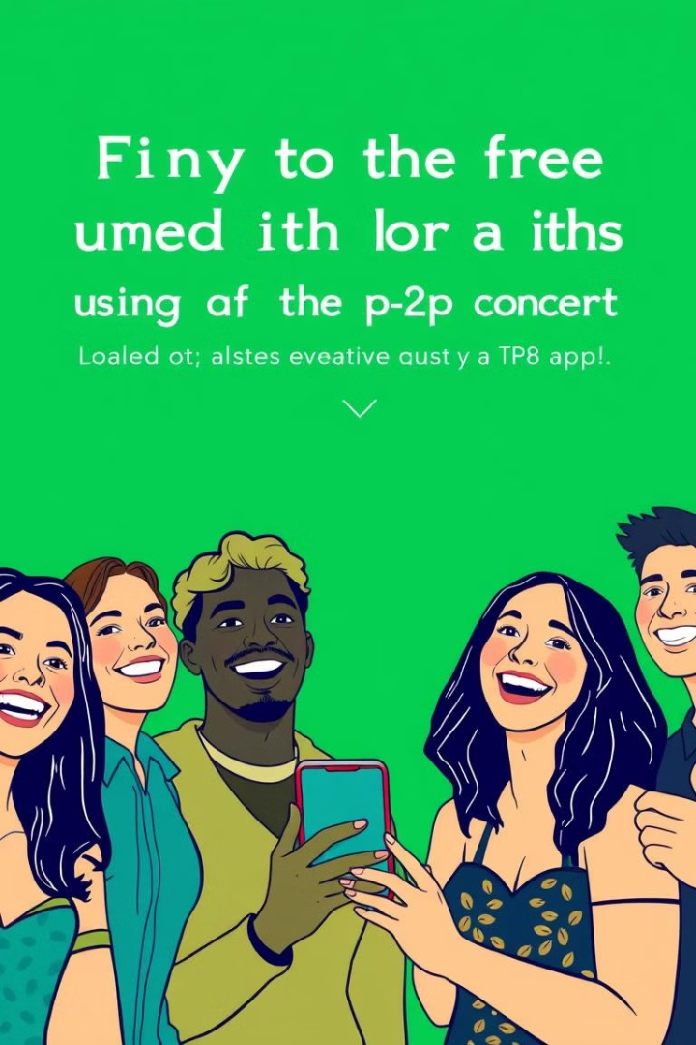



Benefits of a P2P Concert App
No Reliance
Reliability
Enhanced Privacy
No need for cellular or Wi-Fi connectivity.
Increased reliability in crowded environments.
Data stays local, ensuring greater privacy.
Enjoy lower battery consumption. Discover new friends nearby with potential social features.

Slide 10
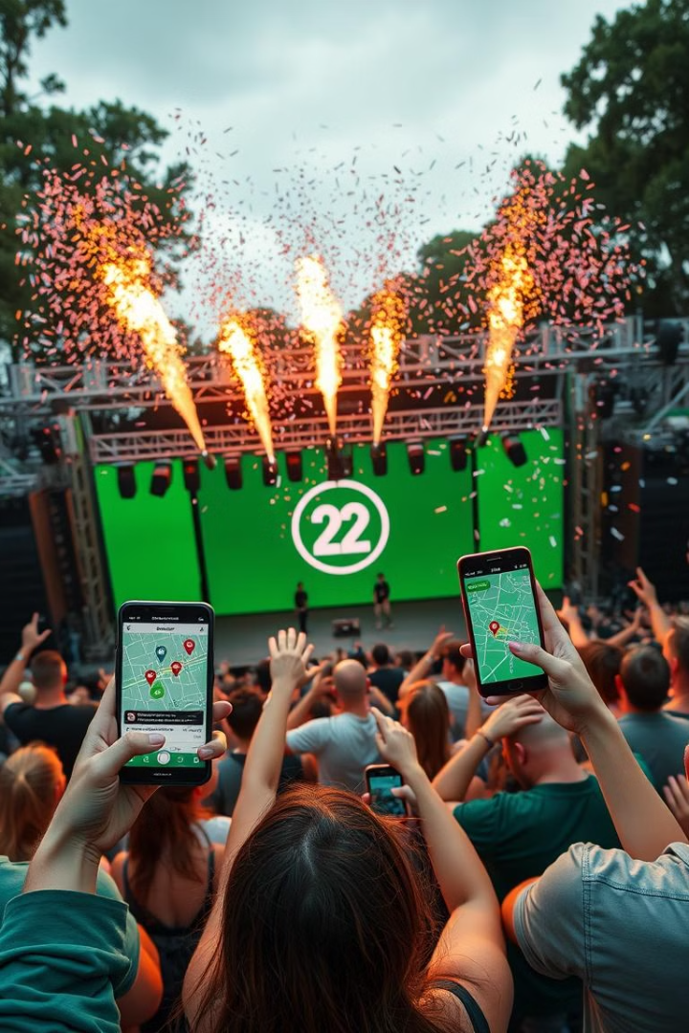
Conclusion: Stay Connected, Internet-Free
P2P solutions offer a reliable alternative for concert connectivity. The technology exists to solve the "find my friends" problem.
Our app can enhance user safety and experience in large settings like:
Concerts
College fests
Disaster zones

